Slide 1
Section 2.1
The Distance and Midpoint Formulas

Slide 2
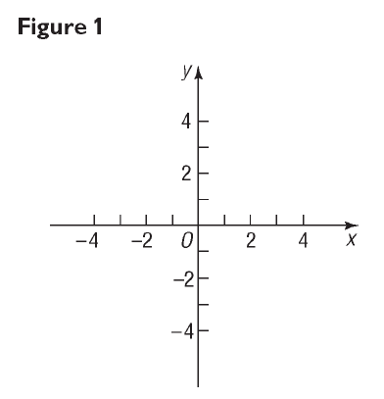
y axis
x axis
origin
Rectangular or Cartesian Coordinate System

Slide 3
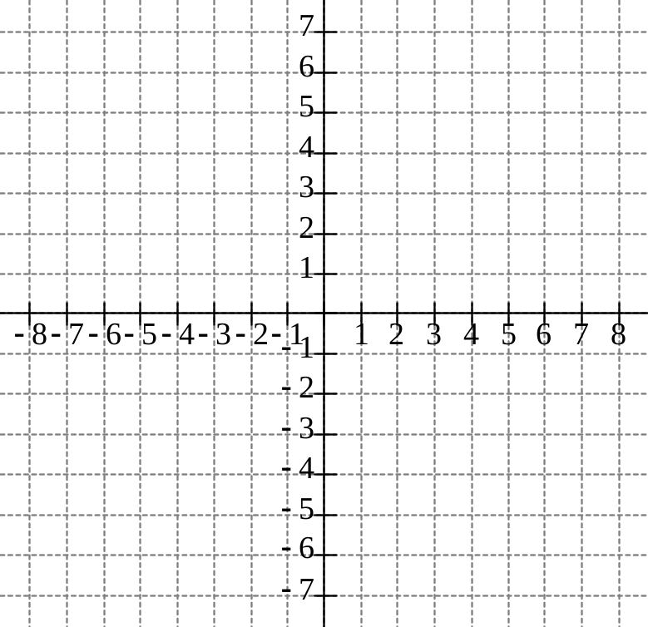
Let's plot the point (6,4).
Let's plot the point (-6,0).
(0,7)
(6,4)
(-6,0)
(-3,-5)
Let's plot the point (-3,-5).
Let's plot the point (0,7).

Slide 4
Quadrant II
x < 0, y > 0
Quadrant I
x > 0, y > 0
Quadrant III
x < 0, y < 0
Quadrant IV
x > 0, y < 0

Slide 5


Slide 6

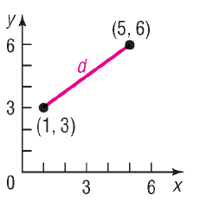
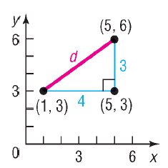



Slide 7
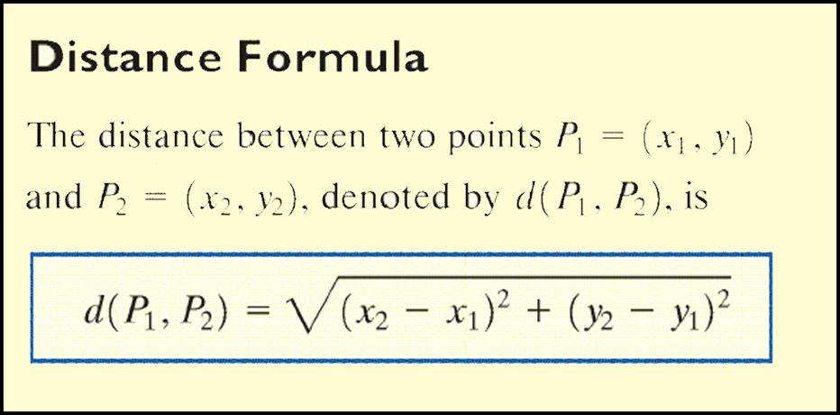

Slide 8
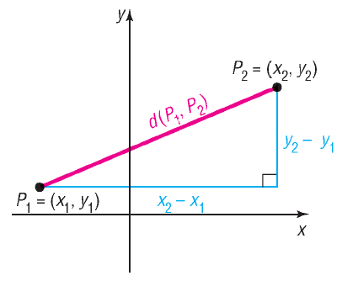
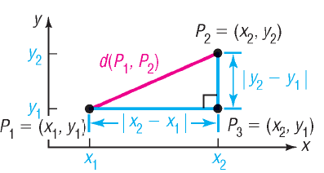
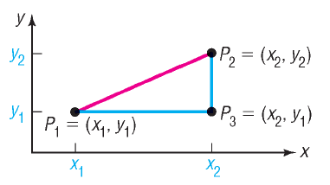




Slide 9
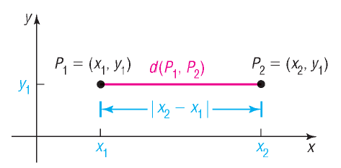
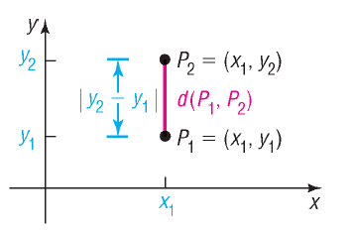
Horizontal or Vertical Segments

Slide 10

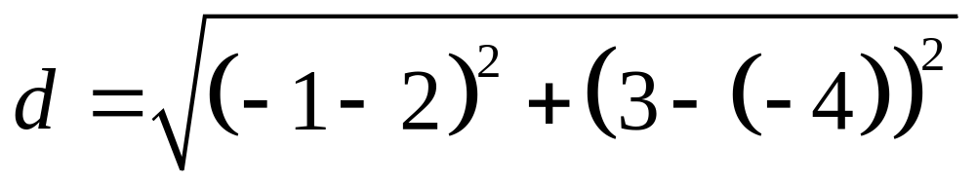
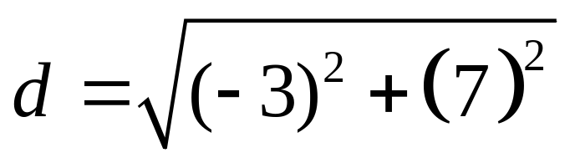
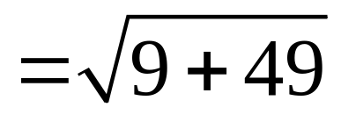
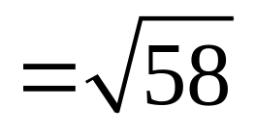
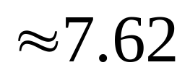
Find the distance d between the points (2, – 4) and (–1, 3).

Slide 11

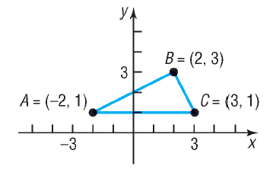

Slide 12




Slide 14


Slide 15
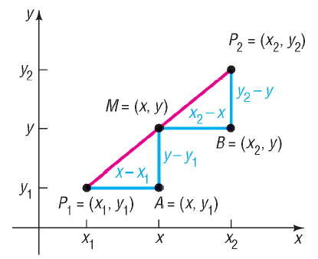
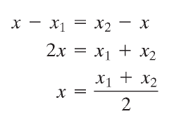
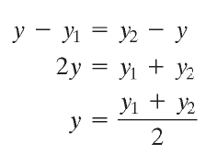

Slide 16
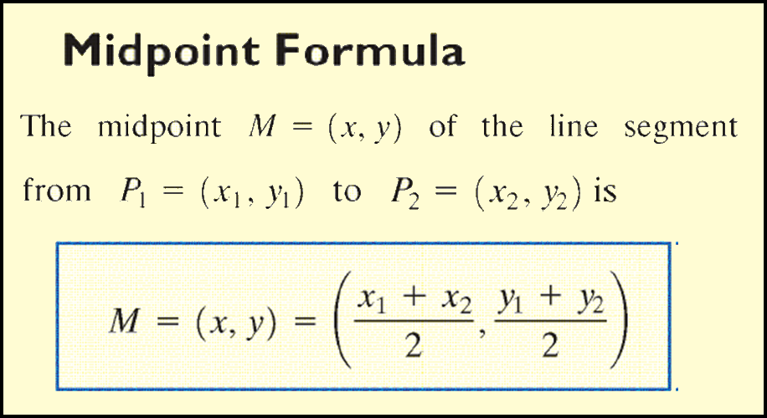

Slide 17
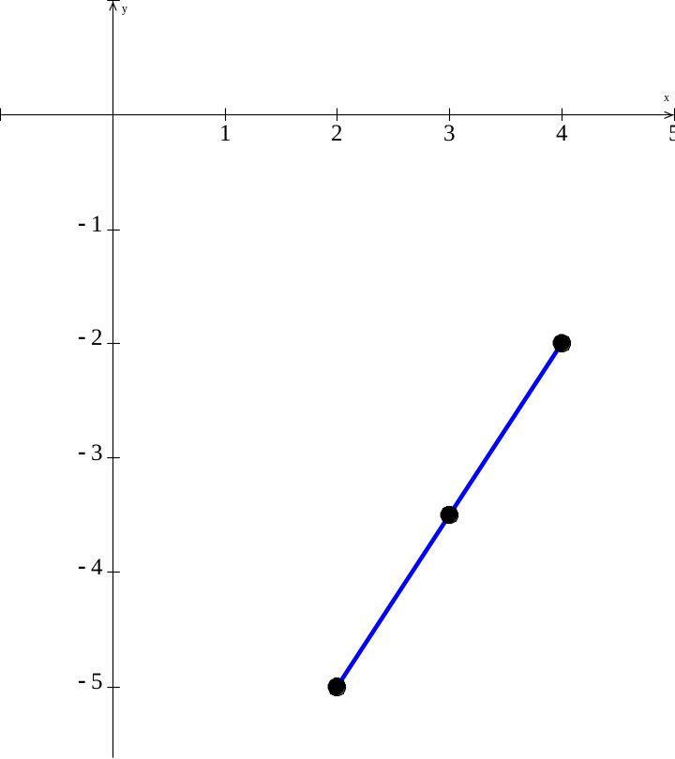
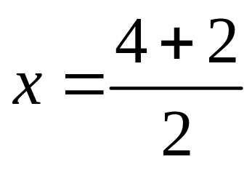
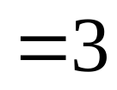
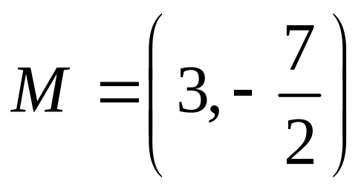
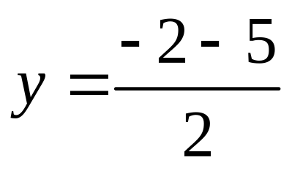
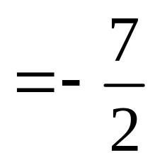

Find the midpoint of the line segment from P₁ = (4, –2) to P₂ = (2, –5). Plot the points and their midpoint.
P₁
M
P₂

